Slide 1
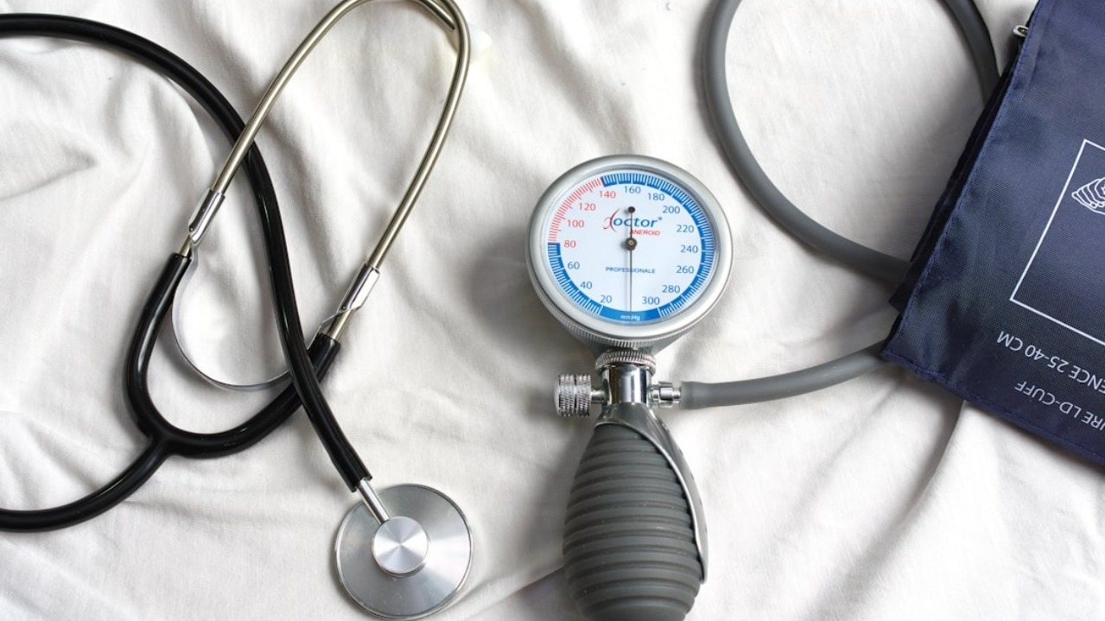
HYPERTENSION: SILENT DESTROYER Uncovering Hidden Adverse Drug Reactions in Hypertensive Patients
VARSHA SANE: EUID: vs1625
SAI SHIVANI PARIMI: EUID: sp3403
SUNITHA BYRAPAKA: EUID: sb3073
RIA SINGH: EUID: rs1711
SRAVANI PULMADI: EUID: sp3194

Slide 2
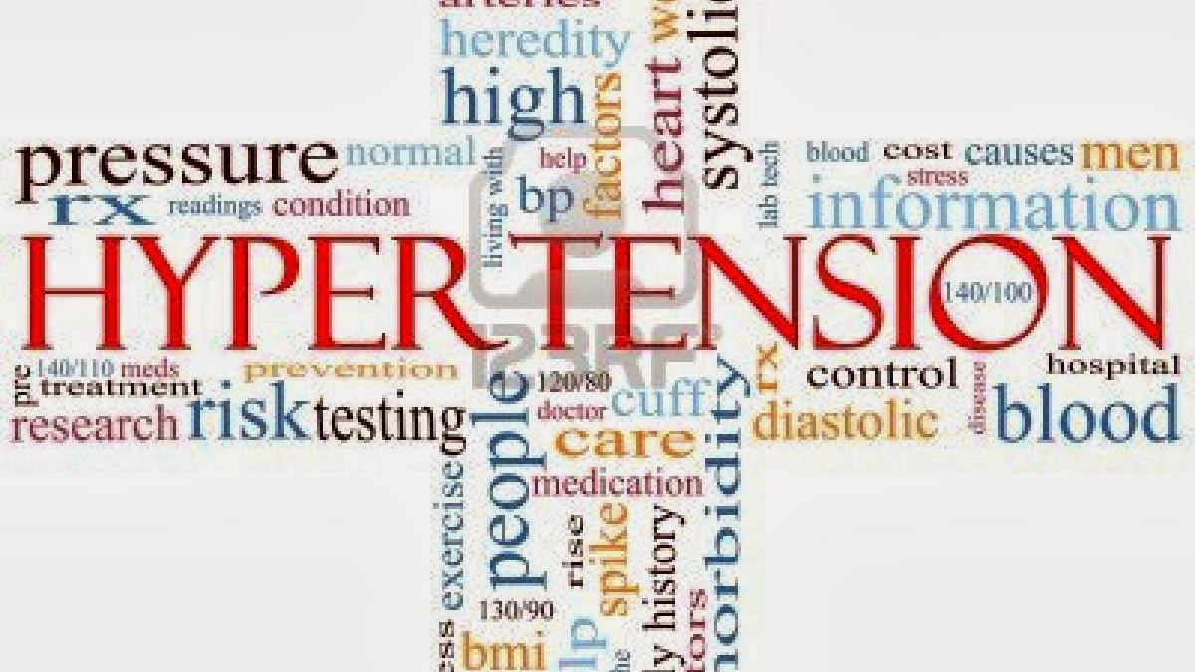
Topic Outline
Introduction
Research Questions
Results
Conclusion & Discussion
This Photo by Unknown Author is licensed under CC BY-NC-ND

Slide 3
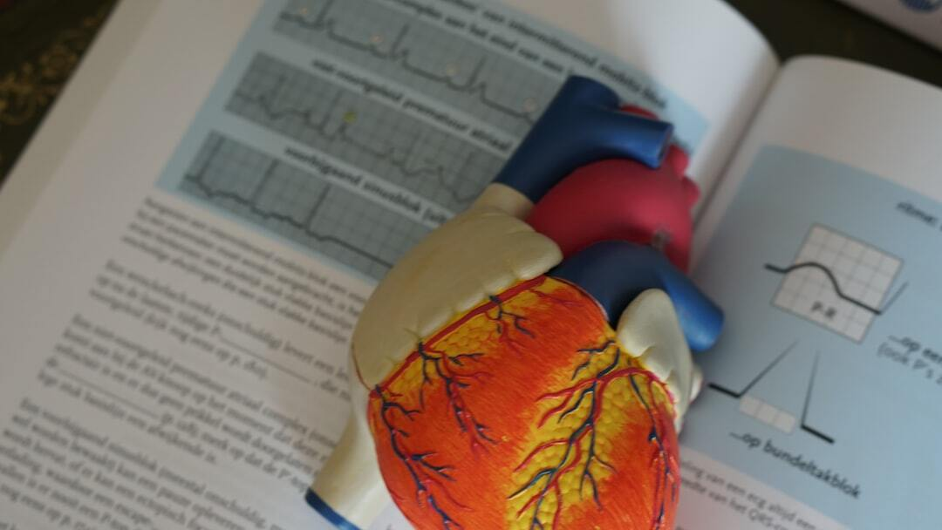
Hypertension: A Silent Killer Understanding Its Prevalence and Impact
Global Burden: Over 1.28 billion people worldwide are affected by hypertension, with nearly half unaware of their condition.
Silent Symptoms: Hypertension shows no clear symptoms but leads to life-threatening conditions such as stroke, heart failure, and kidney disease.
Underdiagnosis & Treatment Gap: Only 42% of hypertensive individuals are diagnosed and treated, contributing to high morbidity and mortality rates.

Slide 4

Causes and Risk Factors of Hypertension Understanding the Modifiable and Non-Modifiable Contributors
Primary vs. Secondary Hypertension
Primary accounts for 90–95% of cases with no identifiable cause; secondary arises from specific conditions like kidney disease.
Modifiable Risk Factors
Include high salt intake, obesity, smoking, sedentary lifestyle, and alcohol abuse.
Non-Modifiable Risk Factors
Genetics, age, and family history are major contributors beyond individual control.

Slide 5

Health Implications of Hypertension Long-term Effects and Chronic Disease Burden
Cardiovascular Disease
Hypertension is a primary contributor to heart attacks, heart failure, and arrhythmias.
Renal Damage
Chronically elevated BP injures kidney vasculature, causing chronic kidney disease (CKD).
Neurological Impact
Increases risk of stroke and vascular dementia due to damaged cerebral arteries.

Slide 6



Global Epidemiology of Hypertension A Public Health Challenge in Both Developed and Developing Nations
High Global Prevalence
1.28 billion adults globally are hypertensive; over 46% remain undiagnosed.
Regional Disparities
Developing nations show higher rates of undiagnosed and uncontrolled hypertension.
Poor Awareness & Control
Low rates of awareness and control are persistent worldwide despite treatment availability.

Slide 7



Management and Treatment of Hypertension Lifestyle Interventions and Pharmacological Options
Pharmacological Treatments
Medications like diuretics, ACE inhibitors, beta-blockers, and calcium channel blockers.
Lifestyle Modifications
Includes dietary changes (DASH), physical activity, alcohol reduction, and smoking cessation.
DASH Diet
Proven effective in lowering BP with emphasis on fruits, vegetables, and low-fat dairy.

Slide 8

Research Questions
Are certain hypertension drugs associated with a higher number of disproportionate adverse event signals compared to others?
What are the most frequently reported adverse events with high PRR? Or What PTs (Preferred Terms) are disproportionately reported across multiple drugs?
Which drug–event combinations have the highest PRR values?
Are there any unexpected or underreported adverse events linked to antihypertensive drugs?
Do some antihypertensive drugs show co-occurring AEs suggestive of class-specific effects?
Can ARM reveal meaningful signals missed by PRR, and which warrant further investigation?

Slide 9
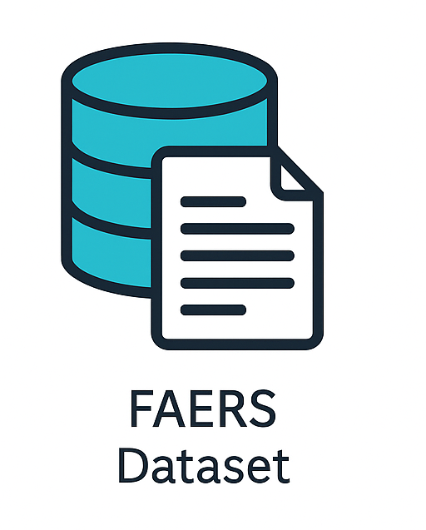
METHODS
1. Data Normalization & Filtering
Used FAERS data filtered for hypertensive patients.
Standardized drug names via UMLS RxNorm API.
Generated normalized drug mapping.

Slide 10
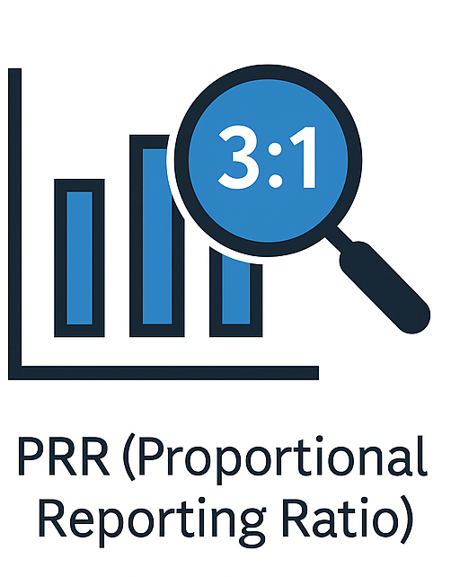
METHODS
2. PRR (Proportional Reporting Ratio)
PRR is used to detect if a specific drug-adverse event pair is reported disproportionately compared to other drugs and events.
Formula: PRR=c/(c+d)a/(a+b)​
a: reports with both the drug and the AE
b: reports with the drug but other AEs
c: reports with the AE but other drugs
d: all other reports
Interpretation: PRR > 1 indicates higher-than-expected reporting; we used PRR > 3 and a ≥ 3 as thresholds for strong signals.
This helps identify drugs most frequently linked to specific adverse events.

Slide 11
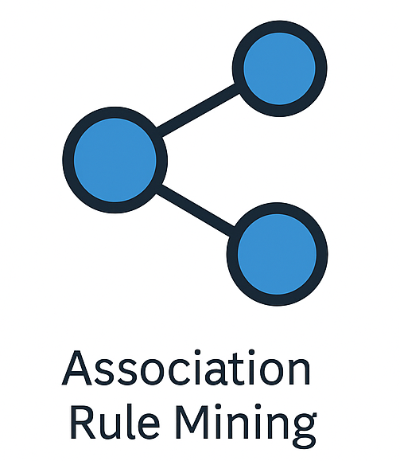
METHODS
3. Association Rule Mining (ARM)
ARM identifies frequent combinations of drugs and symptoms.
Used Apriori algorithm from the mlxtend library.
Data was transformed into a binary matrix (1 if item present, 0 otherwise).
Generated association rules of size 2 and 3 itemsets.
Key metrics:
Support: How often the itemset appears in the dataset (we used >1%)
Confidence: Likelihood of consequence given the antecedent (used >0.3)
Lift: Strength of the rule over random chance (used >2)
ARM helps uncover hidden symptom clusters or drug-event co-occurrences not visible through pairwise analysis like PRR.

Slide 12

Results

Slide 13
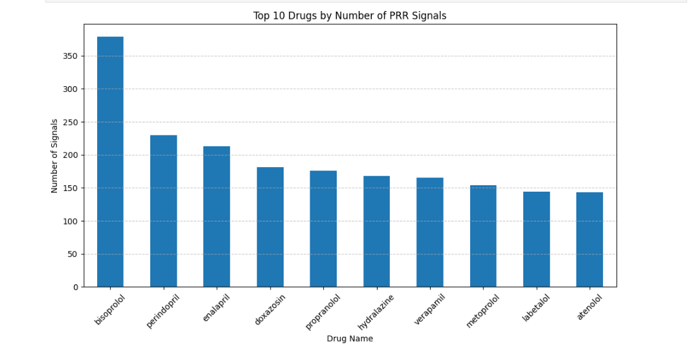
Q1:Are certain hypertension drugs associated with a higher number of disproportionate adverse event signals compared to others?

Slide 14
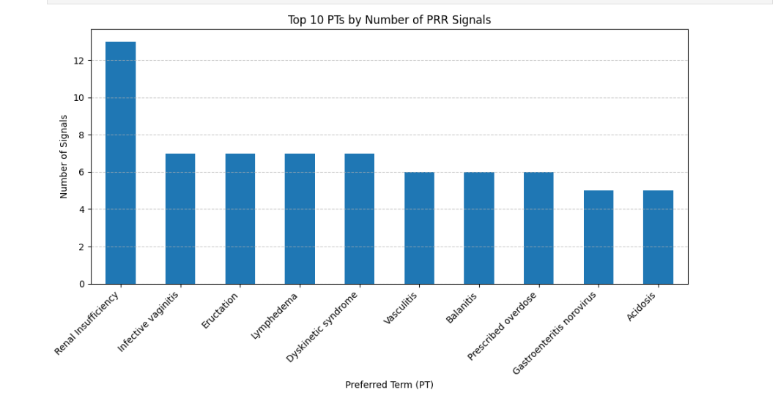
Q2: What PTs (Preferred Terms) are disproportionately reported across multiple drugs?

Slide 15
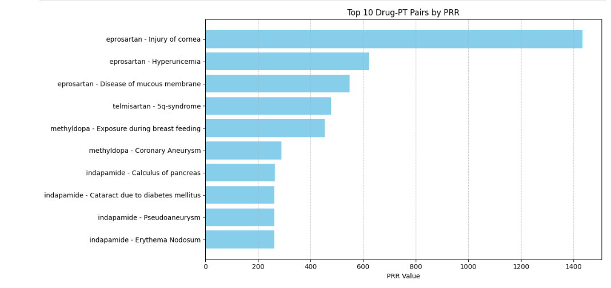
Q3: Which drug–event combinations have the highest PRR values?

Slide 16
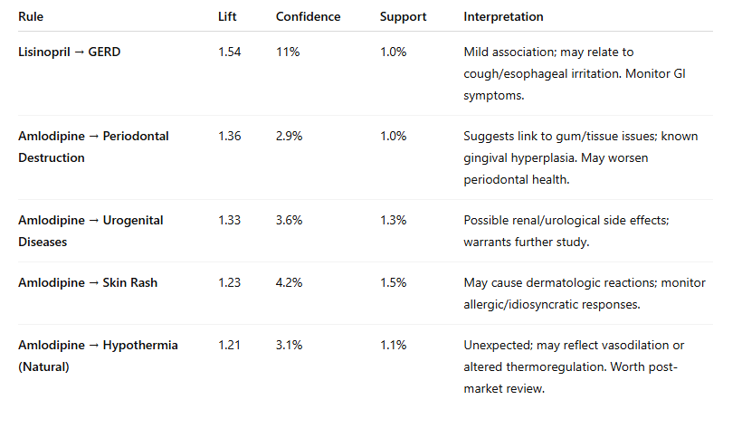
Interpretation of results for Association Rule Mining

Slide 17
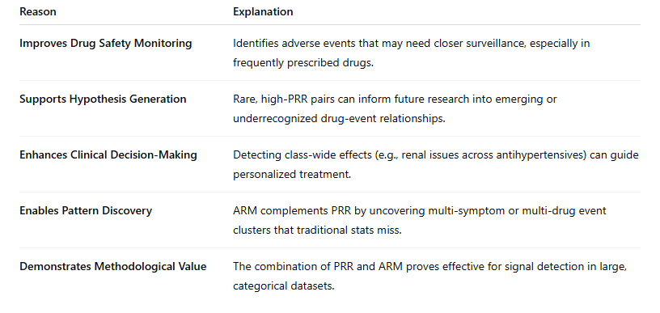

DISCUSSION

Slide 18
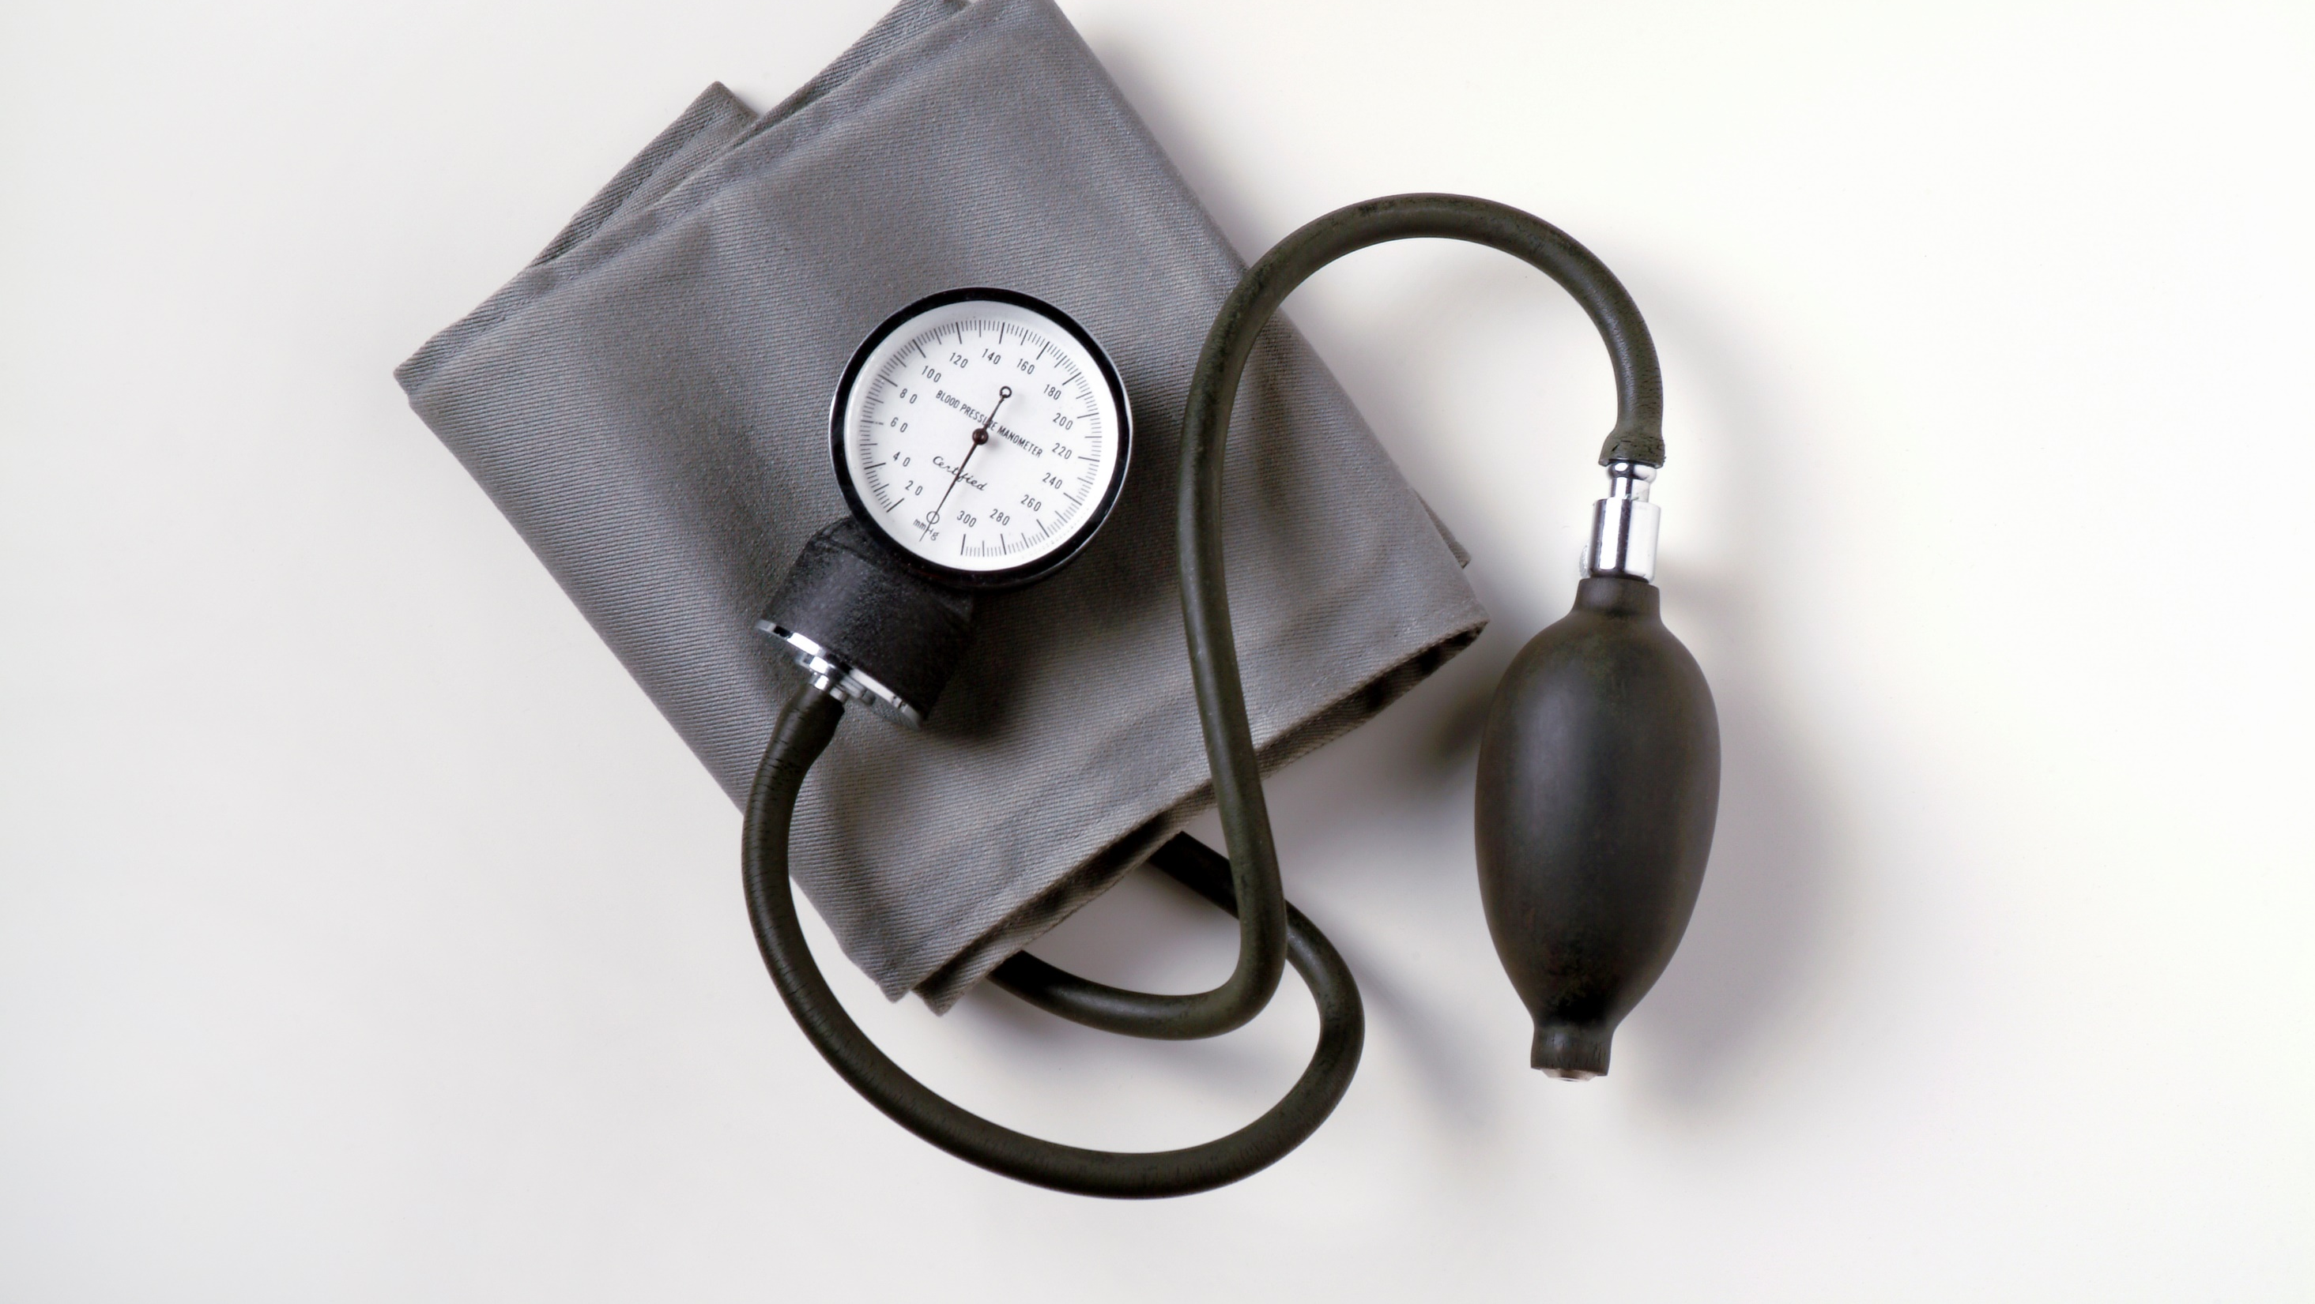
References
Carey, R. M., Muntner, P., Bosworth, H. B., & Whelton, P. K. (2018). Prevention and control of hypertension: JACC health promotion series. Journal of the American College of Cardiology, 72(11), 1278-1293. https://doi.org/10.1016/j.jacc.2018.07.008
Fryar, C. D., Ostchega, Y., Hales, C. M., Zhang, G., & Kruszon-Moran, D. (2017). Hypertension prevalence and control among adults: United States, 2015-2016. NCHS Data Brief, (289), 1-8. https://www.cdc.gov/nchs/data/databriefs/db289.pdf
Mills, K. T., Stefanescu, A., & He, J. (2020). The global epidemiology of hypertension. Nature Reviews Nephrology, 16(4), 223-237. https://doi.org/10.1038/s41581-019-0244-2

Slide 19
References
Muntner, P., Carey, R. M., Gidding, S., Jones, D. W., Taler, S. J., Wright, J. T., & Whelton, P. K. (2020). Potential US population impact of the 2017 ACC/AHA high blood pressure guideline. Journal of the American College of Cardiology, 71(2), 109-118. https://doi.org/10.1016/j.jacc.2017.10.073
Oparil, S., Acelajado, M. C., Bakris, G. L., Berlowitz, D. R., Cífková, R., & Dominiczak, A. F. (2018). Hypertension. Nature Reviews Disease Primers, 4, 18014. https://doi.org/10.1038/nrdp.2018.14
World Health Organization: WHO & World Health Organization: WHO. (2023, March 16). Hypertension. https://www.who.int/news-room/fact-sheets/detail/hypertension

Slide 20

Thank you

Slide 21


Questions?

